Slide 1
UNCLASSIFIED
UNCLASSIFIED
II Marine Expeditionary Force
(MEF)
24 October 2017
NDIA
Expeditionary Warfare Conference
Updated: 20 October 17
UNCLASSIFIED

Slide 2
Purpose / Agenda
UNCLASSIFIED
Purpose:
To provide current and future overview of II MEF while addressing operational challenges and conceptual engagements.
Agenda:
II MEF Overview
Mission
Task Organization
MAGTF Across the ROMO
Global Engagement
MEB and MEU Operations
Current and Future
Operational Challenges
Conceptual Engagement
Where Can You Help
What Matters to Us
UNCLASSIFIED
2

Slide 3
II MEF Mission
UNCLASSIFIED
“The MEF remains our most capable MAGTF and is and will remain capable of conducting major operations in the littorals, ashore, and inland.”
Marine Corps Operating Concept, Sept 2016
When directed, II MEF deploys and is employed as a Marine Air Ground Task Force (MAGTF) in support of Combatant Commander (CCDR) requirements for contingency response or Major Theatre War; with appropriate augmentation, serves as the core element of a Joint Task Force (JTF); prepares and deploys combat ready MAGTF to support CCDR presence and crisis response; and supports service and CCDR initiatives as required.
UNCLASSIFIED
3

Slide 4
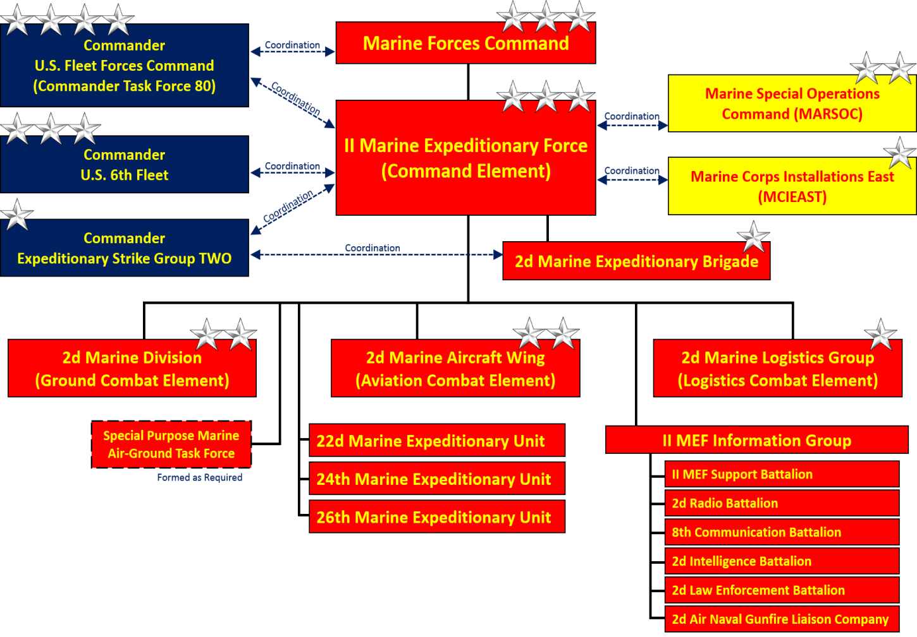
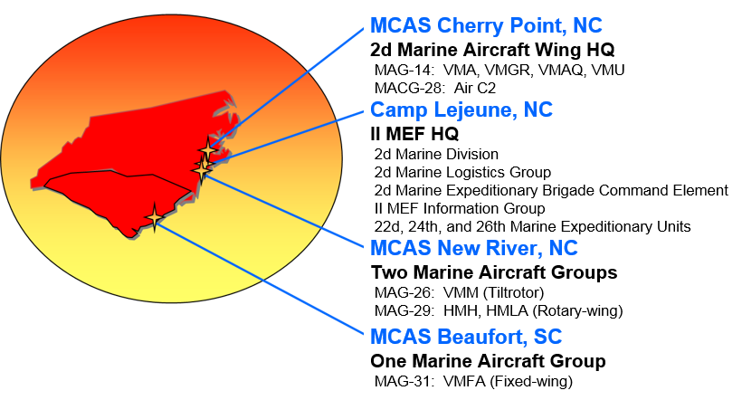
II Marine Expeditionary Force
UNCLASSIFIED
II MEF is
Home to over 40K Marines and Sailors deployed worldwide.
Postured both at forward-deployed locations and at home, to rapidly respond to crises or contingencies around the globe – across the full Range of Military Operations (ROMO).
Tailorable and scalable.
UNCLASSIFIED
4
Notes:
II Marine Expeditionary Force (MEF) is one of three MEFs in the Marine Corps. I MEF is in California and III MEF is in Okinawa.
With more than 43,000 Marines and Sailors, II MEF is representative of the largest and most powerful Marine Air-Ground Task Force (MAGTF).
II MEF Consists of:
(1) II MEF Information Group containing personnel and equipment necessary for the effective planning and execution of operations.
(2) A ground combat element, the 2d Marine Division.
(3) An aviation combat element, the 2nd Marine Aircraft Wing.
(4) A combat service support element, the 2nd Marine Logistics Group.
A unique aspect of the Corps is its ability to quickly and efficiently tailor (right capabilities) and scale (right size) a force by on the operational requirements.
Our Corps’ task is to organize for combat in accordance with our statutory mandate to provide forces of combined arms, including aviation, by forming integrated combined arms MAGTFs. As the name indicates, the organization of the MAGTFs is specific to the tasks-at-hand and is mission-tailored for rapid deployment by air and/or sea. No matter what their mission or mode of deployment may be, the MAGTFs are comprised of four deployable elements supported from our bases and stations.

Slide 5
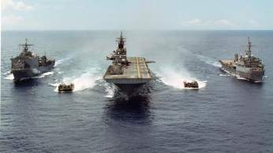
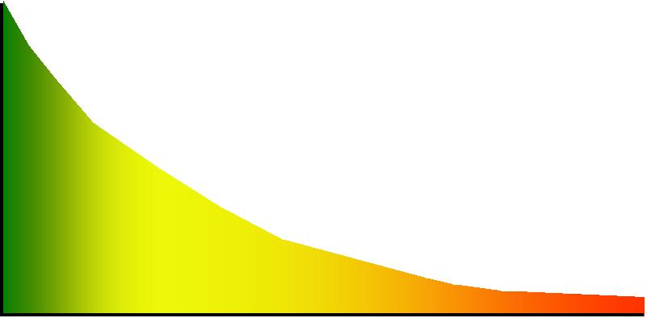
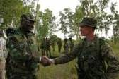
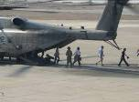
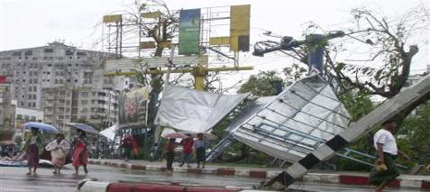
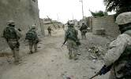
UNCLASSIFIED
MAGTF Capabilities Across the ROMO
Special Purpose
Marine Air-Ground
Task Forces
(SPMAGTFs)
Marine Expeditionary
Unit
(MEU)
Marine Expeditionary
Brigade
(MEB)
Theater Security
Cooperation
Marine Expeditionary
Force
(MEF)
NEOs
Humanitarian Assistance
Disaster Relief
Counterinsurgency
Joint Forcible Entry
Mid-Intensity Conflict
Crisis Response ……Contingency Ops
Major Combat Operations
Partner and Prevent
Integrated with Combatant Commander Theater Campaign Plans
UNCLASSIFIED
5
Notes:
The intent of this slide is to show the utility of the MAGTF across the ROMO…from Crisis Response and Limited Contingency Operations to Major Operations and Campaigns.
This slide gives a sense of the capability that each MAGTF can provide. At the lower end of the range of military operations is the SPMAGTF. The MEU constitutes a crisis response capability and is organized and trained to respond to humanitarian crises, non-combatant evacuations, and other crises within its capabilities. Although capable of conducting security cooperation activities, the MEU is principally tailored to constitute the theater reserve for a combatant commander. Recent MEU deployments have also seen the MAGTF supporting sustained combat operations in Iraq and Afghanistan. The MEB is the first level of MAGTF where joint forcible entry operations become realized; with more robust capabilities. MEBs can also support sustained combat operations on the lower end of the ROMO, such as COIN or act as a MEF (Fwd) to provide the first echelon of a MEF before that MAGTF arrives in theater. The MEF constitutes the Marine Corps big war-fighting punch. The MEF provides a robust joint forcible entry capability with two MEBs in the amphibious assault echelon and an additional MEB in the assault follow-on echelon. The MEF, as evidenced by Operation Desert Storm and Operation Iraqi Freedom, is capable of sustained combat operations.
An important distinction to draw from these MAGTFs is that they are multicapable and able to conduct many different types of operations across the ROMO. OSD tends to bin Marine MAGTFs as general purpose forces (GPF), but the reality is that our MAGTFs are multicapable– flexible, adaptable, and agile, Marine MAGTFs provide a myriad of capabilities to meet the requirements of the combatant commander.
Slide built by PP&O.
5

Slide 6
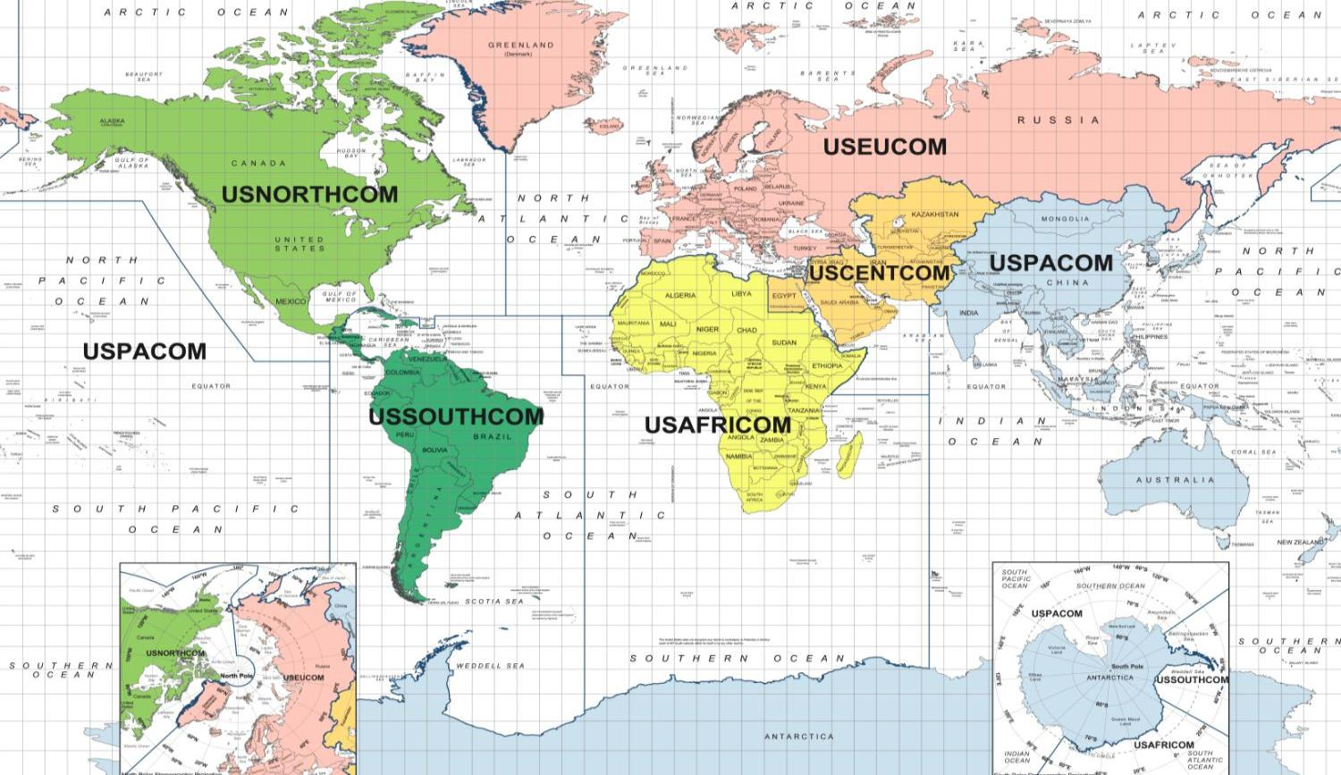
II MEF Globally Engaged
UNCLASSIFIED
II MEF is globally engaged in every Combatant Command and is poised to respond to crisis.
SYRIA
Individual Augments
Elements of II MEF
ROMANIA/NORWAY:
BSRF
MSR-E
GEORGIA
Advise and Assist
UK
Supporting Arms Ex
Bold Alligator 17
Weapons Tactics Instructor Course
AFGHANISTAN
Advise and Assist TM
JAPAN
Forward Presence
Mountain EX
Integrated Training EX
KUWAIT + UAE
Enablers
MEU & VMM
Hurricane Relief, PR
SPAIN/ITALY/AFRICA
Theater Security Cooperation
HONDURAS/BELIZE/PERU/DOMINICA
Theater Security Cooperation, Hurricane Relief, Water Purification
BAHRAIN
Close Air Support
Afloat Pacific
Tactical Air Integration
IRAQ
CI/HUMINT DET
TOTAL II MEF ASSIGNED FORCES ~ 42,000
TOTAL II MEF SUSTAINED/DEPLOYED ~ 7,000
UNCLASSIFIED
6
Notes:
We are also globally engaged in all (6) Geographic Combatant Commands
This slide depicts at a given snapshot, where we have II MEF forces deployed/engaged in either operations or exercises across the globe.
This incorporates, Major Training, Exercise, and Operational commitments.
This is generally a normal operating picture for II MEF on a day to day basis.

Slide 7
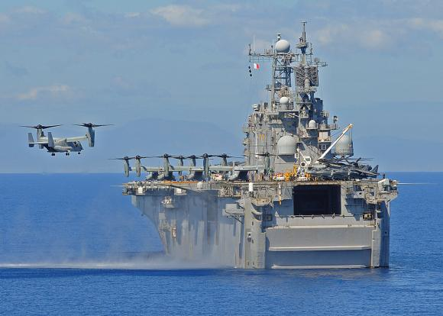
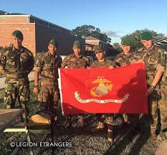
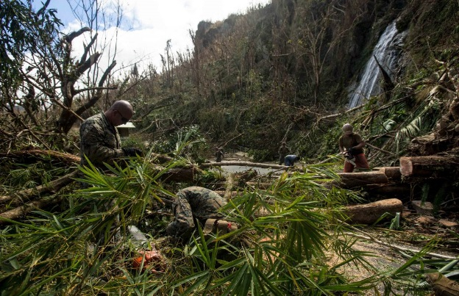
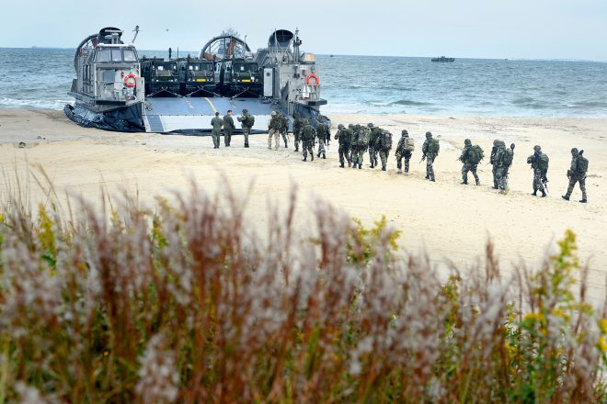
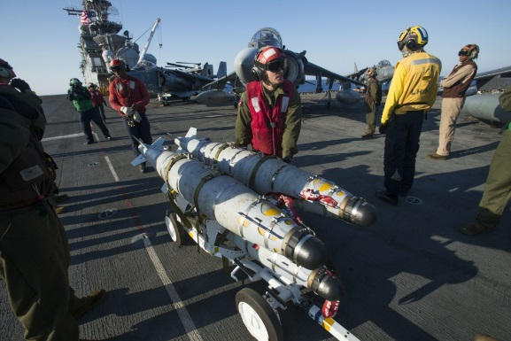
UNCLASSIFIED
2d MEB and MEU Operations
2d Marine Expeditionary Brigade
Supports MARFORAF w/ready joint capable task force (JTF)
Crisis response in support of combatant commands
On going: BOLD ALLIGATOR 17
Recent exercises : JUDICIOUS RESPONSE 17, MPFEX 17, COLD RESPONSE 16
24 Marine Expeditionary Unit
USCENTCOM – Inherent Resolve
USEUCOM
Hurricane Relief Ops
26 Marine Expeditionary Unit
Pre-deployment Work-Up
Hurricane Relief Ops
22 Marine Expeditionary Unit
USEUCOM – Odyssey Lightning
USCENTCOM – Maritime Security Ops
UNCLASSIFIED
7
Notes:
French Foreign Legion detachment with USMC during BA 17
Rehearsals with LCAC for BA 17
Marines in PR clearing roads
Harriers ISO of Odyssey Dawn

Slide 8
II MEF in 2015
UNCLASSIFIED
PRIORITIES
Global Force Management (GFM)
Crisis response (2d MEB)
MEF Warfighting
MEF
Warfighting
GFM
UNCLASSIFIED
8

Slide 9
CMC FY 19-23 Force Management Plan (FMP)
UNCLASSIFIED
FORCE MANAGEMENT PLAN FY 19-23 Goal
A ready-force postured in accordance with SecDef, CJCS, and CMC guidance, satisfying NMS objectives, JSCP objectives, and Theater Plan requirements, and managed/allocated in a manner that facilities readiness and Force Development.
CMC FY 19-23 FMP
Classified Document released in May 2017
Revises the threat focus
Changes previous Service priorities and focus as they relate to:
OPLANs/CONPLANs
MAGTF Warfighting
Training and Exercises
Readiness
“These institutional efforts (MOC and FD 2025 Initiative) were spurred by a critical self-assessment that revealed that the Marine Corps is not organized, trained, equipped, or postured to meet the demands of the rapidly evolving future operating environment. “
CMC Senate Testimony, May 24, 2017
UNCLASSIFIED
9
Notes:
FMP Classified document. FMP Yellow box unclassified paragraph from FMP

Slide 10
II MEF in 2019-2023
UNCLASSIFIED
PRIORITIES
MEF Warfighting
Global Force Management (GFM)
Crisis response (2d MEB)
GFM
MEF
Warfighting
UNCLASSIFIED
10

Slide 11
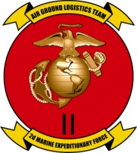
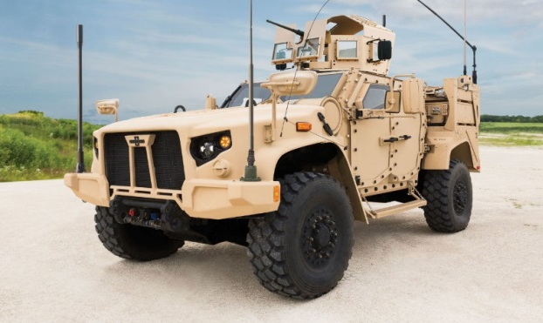
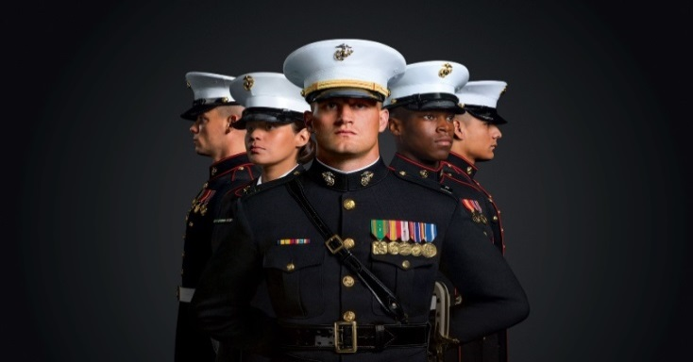
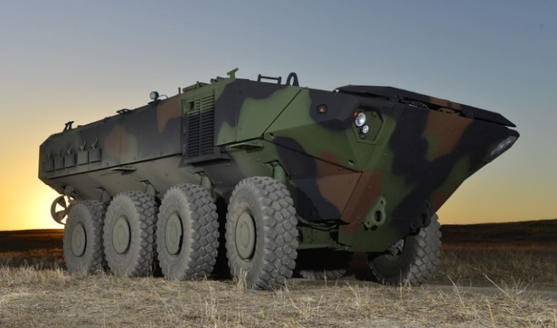
Operational Challenges
UNCLASSIFIED
Manpower
Readiness and Funding
Equipment and Capabilities
II MEF is actively engaged in all the operational challenges; from supporting concepts, providing expertise to numerous conferences, working groups, and wargames.
We provide significant input throughout the POM process, and support experimentation that leads to solutions.
UNCLASSIFIED
11
Notes:
Info from rom CMC Testimony FY18 and FY 17 Budgets
MANPOWER
Quality manpower is the Corps’ friendly center of gravity
182K to 185K
Establishment of MEF Information Groups (MIGs)
Continue to recruit and retain the best
Leverage our Reserve Marines
Improve Deployment to Dwell Ratio
READINESS AND FUNDING
Fiscal reductions and budget instability have affected readiness
Reduced modernization to support maintenance of legacy equipment
Focus on training and equipping deployed, and next-to-deploy units at the expense “ready bench”
The “ready bench” focus to respond to crisis and contingencies are not as ready or capable as necessary
Aviation units in the midst of focused recovery effort
Working to expand and enhance “ready bench”
Equipment Reset strategy
Review and revise operational commitments
Engagement with Congress to increase O&M
Equipment - MAY NOT WANT TO ENGAGE IN NAVAL AMPHIB ISSUES AND 38 SHIP Requirement in this forum.
Naval
Lack of Amphibious shipping, ship to shore connectors (SSC) and Mine Countermeasure (MCM) capabilities
LCAC – 25 years old
LCU – 58 years old
Aviation
F-35 to replace the AV-8B, F/A-18, and EA-6B
Accelerate procurement and increase in funding
Upgrades CH-53K, UH-1Z and AH-1Y
Accelerate procurement and increase in funding
Ground
LAV – 33 years old
M1A1 – 26 years old
AAV being replaced by Amphibious Combat Vehicle (ACV)
Joint Light Tactical Vehicle

Slide 12
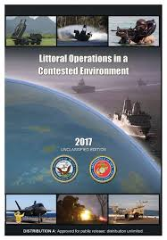
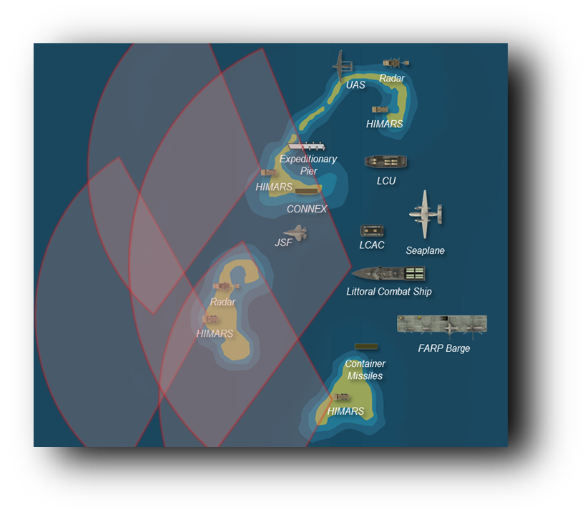
Conceptual Engagement
UNCLASSIFIED
II MEF is incorporating the MOC, LOCE and emerging EABO concepts within its training and exercises.
Supporting MCWL experimentation initiatives.
Providing critical feedback to CMC and other appropriate naval organizations.
UNCLASSIFIED
12

Slide 13
Where can you help?
UNCLASSIFIED
Cost effective live, virtual and constructive training support from the individual Marine to MAGTF commanders
Develop/enhance kinetic and non-kinetic capabilities to penetrate complex A2/AD threats to gain and maintain access
Develop resiliency within our networks to counter ability of adversaries to signifantly degrade or deny our ability to C2
Engage in providing solutions to distributed C2, fires, mobility, sustainment and force protection
Simplify naval, joint, SOF and coalition interoperability
Simplify integrated ISR architecture
UNCLASSIFIED
13

Slide 14
UNCLASSIFIED
What Matters to Us
Operational Excellence
Mission Focused
Lethal, Relevant, Professional
You Can Count on Us
Readiness
Ready Marines/Sailors
Ready Machines
Ready Families
Standards
Marines/Sailors First
MOS Proficiency Always
Protect What You’ve Earned
Dignity & Respect
We All Earned our Eagle, Globe & Anchor
Golden Rule
Core Values
One Team, One Fight
Operational
Excellence
Readiness
Dignity
&
Respect
Standards
UNCLASSIFIED
14

Slide 15
Questions
UNCLASSIFIED
UNCLASSIFIED
15
Notes:
Questions

